Slide 1
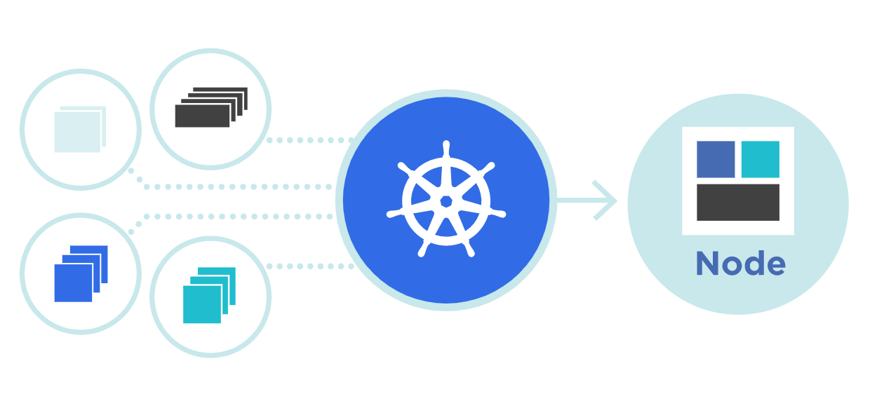



Kubernetes
Etcd backup & Restore
Theory + LAB + Documents ➔ All free
WATCH NOW
Notes:
Hello everyone. My name is Anish Rana and you are watching Kubernetes web series.

Slide 2
ETCD snapshot & Backup
Understanding the basic of etcd
Install ETCD package
How to create ETCD snapshot?
How to restore from snapshot?
Lab + Exam preparation

Slide 3
01 NOW WE WILL TALK ABOUT
Understanding the basic of etcd

Slide 4
kubectl get pods –A
NAMESPACE NAME READY STATUS RESTARTS AGE
kube-system calico-kube-controllers-798cc86c47-phlnc 1/1 Running 2 (27m ago) 269d
kube-system calico-node-672fx 1/1 Running 2 (27m ago) 269d
kube-system calico-node-c5kn4 1/1 Running 20 (138m ago) 269d
kube-system calico-node-tszjn 1/1 Running 20 (134m ago) 269d
kube-system coredns-565d847f94-m4pjz 1/1 Running 2 (27m ago) 269d
kube-system coredns-565d847f94-z2crd 1/1 Running 2 (27m ago) 269d
kube-system etcd-master1.example.com 1/1 Running 3 (23m ago) 269d
kube-system kube-apiserver-master1.example.com 1/1 Running 4 (23m ago) 269d
kube-system kube-controller-manager-master1.example.com 1/1 Running 7 (23m ago) 269d
kube-system kube-proxy-4nkf7 1/1 Running 19 (138m ago) 269d
kube-system kube-proxy-g2pwp 1/1 Running 19 (136m ago) 269d
kube-system kube-proxy-hv8wh 1/1 Running 3 (23m ago) 269d
kube-system kube-scheduler-master1.example.com 1/1 Running 7 (23m ago) 269d
Etcd is a database server
It runs on kube-system namespace
Etcd pod is a static pod.
It runs on port number 2379

Slide 5
cat /etc/kubernetes/manifests/etcd.yaml
apiVersion: v1
kind: Pod
metadata:
annotations:
kubeadm.kubernetes.io/etcd.advertise-client-urls: https://192.168.1.31:2379
creationTimestamp: null
labels:
component: etcd
tier: control-plane
name: etcd
namespace: kube-system
spec:
containers:
- command:
- etcd
- --advertise-client-urls=https://192.168.1.31:2379
- --cert-file=/etc/kubernetes/pki/etcd/server.crt
- --client-cert-auth=true
- --data-dir=/var/lib/etcd
- --experimental-initial-corrupt-check=true
- --experimental-watch-progress-notify-interval=5s
- --initial-advertise-peer-urls=https://192.168.1.31:2380
- --initial-cluster=master1.example.com=https://192.168.1.31:2380
- --key-file=/etc/kubernetes/pki/etcd/server.key
- --listen-client-urls=https://127.0.0.1:2379,https://192.168.1.31:2379
- --listen-metrics-urls=http://127.0.0.1:2381
- --listen-peer-urls=https://192.168.1.31:2380
- --name=master1.example.com
- --peer-cert-file=/etc/kubernetes/pki/etcd/peer.crt
- --peer-client-cert-auth=true
- --peer-key-file=/etc/kubernetes/pki/etcd/peer.key
- --peer-trusted-ca-file=/etc/kubernetes/pki/etcd/ca.crt
- --snapshot-count=10000
- --trusted-ca-file=/etc/kubernetes/pki/etcd/ca.crt
Server cert
Server key
Ca cert
endpoints

Slide 6
- command:
- etcd
- --advertise-client-urls=https://192.168.1.31:2379
- --cert-file=/etc/kubernetes/pki/etcd/server.crt
- --client-cert-auth=true
- --data-dir=/var/lib/etcd
- --experimental-initial-corrupt-check=true
- --experimental-watch-progress-notify-interval=5s
- --initial-advertise-peer-urls=https://192.168.1.31:2380
- --initial-cluster=master1.example.com=https://192.168.1.31:2380
- --key-file=/etc/kubernetes/pki/etcd/server.key
- --listen-client-urls=https://127.0.0.1:2379,https://192.168.1.31:2379
- --listen-metrics-urls=http://127.0.0.1:2381
- --listen-peer-urls=https://192.168.1.31:2380
- --name=master1.example.com
- --peer-cert-file=/etc/kubernetes/pki/etcd/peer.crt
- --peer-client-cert-auth=true
- --peer-key-file=/etc/kubernetes/pki/etcd/peer.key
- --peer-trusted-ca-file=/etc/kubernetes/pki/etcd/ca.crt
- --snapshot-count=10000
- --trusted-ca-file=/etc/kubernetes/pki/etcd/ca.crt
Server cert
Server key
Endpoints: 2379
Ca cert

Slide 7
cat /etc/kubernetes/manifests/etcd.yaml | grep /var/lib/etcd
- --data-dir=/var/lib/etcd
- mountPath: /var/lib/etcd
path: /var/lib/etcd
- command:
- etcd
- --advertise-client-urls=https://192.168.1.31:2379
- --cert-file=/etc/kubernetes/pki/etcd/server.crt
- --client-cert-auth=true
- --data-dir=/var/lib/etcd
- --experimental-initial-corrupt-check=true
- --experimental-watch-progress-notify-interval=5s
- --initial-advertise-peer-urls=https://192.168.1.31:2380
- --initial-cluster=master1.example.com=https://192.168.1.31:2380
- --key-file=/etc/kubernetes/pki/etcd/server.key
- --listen-client-urls=https://127.0.0.1:2379,https://192.168.1.31:2379
- --listen-metrics-urls=http://127.0.0.1:2381
- --listen-peer-urls=https://192.168.1.31:2380
- --name=master1.example.com
- --peer-cert-file=/etc/kubernetes/pki/etcd/peer.crt
- --peer-client-cert-auth=true
- --peer-key-file=/etc/kubernetes/pki/etcd/peer.key
- --peer-trusted-ca-file=/etc/kubernetes/pki/etcd/ca.crt
- --snapshot-count=10000
- --trusted-ca-file=/etc/kubernetes/pki/etcd/ca.crt

Slide 8
volumeMounts:
- mountPath: /var/lib/etcd
name: etcd-data
- mountPath: /etc/kubernetes/pki/etcd
name: etcd-certs
hostNetwork: true
priorityClassName: system-node-critical
securityContext:
seccompProfile:
type: RuntimeDefault
volumes:
- hostPath:
path: /etc/kubernetes/pki/etcd
type: DirectoryOrCreate
name: etcd-certs
- hostPath:
path: /var/lib/etcd
type: DirectoryOrCreate
name: etcd-data
status: {}

Slide 9
kubectl -n kube-system describe pod/etcd-master1.example.com
Controlled By: Node/master1.example.com
Containers:
etcd:
Container ID: containerd://f5722550649c96cfbdfe7ed123cc02c709e5d7ba2bbdc42896ebbf45e29a0f16
Image: registry.k8s.io/etcd:3.5.5-0
Image ID: registry.k8s.io/etcd@sha256:b83c1d70989e1fe87583607bf5aee1ee34e52773d4755b95f5cf5a451962f3a4
Port: <none>
Host Port: <none>
Command:
etcd
--advertise-client-urls=https://192.168.1.31:2379
--cert-file=/etc/kubernetes/pki/etcd/server.crt
--client-cert-auth=true
--data-dir=/var/lib/etcd
--experimental-initial-corrupt-check=true
--experimental-watch-progress-notify-interval=5s
--initial-advertise-peer-urls=https://192.168.1.31:2380
--initial-cluster=master1.example.com=https://192.168.1.31:2380
--key-file=/etc/kubernetes/pki/etcd/server.key
--listen-client-urls=https://127.0.0.1:2379,https://192.168.1.31:2379
--listen-metrics-urls=http://127.0.0.1:2381
--listen-peer-urls=https://192.168.1.31:2380
--name=master1.example.com
--peer-cert-file=/etc/kubernetes/pki/etcd/peer.crt
--peer-client-cert-auth=true
--peer-key-file=/etc/kubernetes/pki/etcd/peer.key
--peer-trusted-ca-file=/etc/kubernetes/pki/etcd/ca.crt
--snapshot-count=10000
--trusted-ca-file=/etc/kubernetes/pki/etcd/ca.crt
Server cert
Data dir
Server key
Endpoints: 2379
Ca cert

Slide 10
02 NOW WE WILL TALK ABOUT
Install etcd package

Slide 11
etcdctl version
curl -s https://api.github.com/repos/etcd-io/etcd/releases/latest | grep browser_download_url | grep linux-amd64 | cut -d '"' -f 4 | wget -qi -
tar xvf etcd-v*.tar.gz
cd etcd-*/
sudo mv etcd* /usr/local/bin/
cd ~
etcdctl version
etcdctl version: 3.4.16
API version: 3.4

Slide 12
[root@master1 ~]# etcdctl snapshot
NAME: snapshot - Manages etcd node snapshots
API VERSION: 3.4
COMMANDS:
restore Restores an etcd member snapshot to an etcd directory
save Stores an etcd node backend snapshot to a given file
status Gets backend snapshot status of a given file
GLOBAL OPTIONS:
--cacert="" verify certificates of TLS-enabled secure servers using this CA bundle
--cert="" identify secure client using this TLS certificate file
--command-timeout=5s timeout for short running command (excluding dial timeout)
--debug[=false] enable client-side debug logging
--dial-timeout=2s dial timeout for client connections
-d, --discovery-srv="" domain name to query for SRV records describing cluster endpoints
--discovery-srv-name="" service name to query when using DNS discovery
--endpoints=[127.0.0.1:2379] gRPC endpoints
--hex[=false] print byte strings as hex encoded strings
--insecure-discovery[=true] accept insecure SRV records describing cluster endpoints
--insecure-skip-tls-verify[=false] skip server certificate verification (CAUTION: this option should be enabled only for testing purposes)

Slide 13
03 NOW WE WILL TALK ABOUT
How to create etcd snapshot?

Slide 14
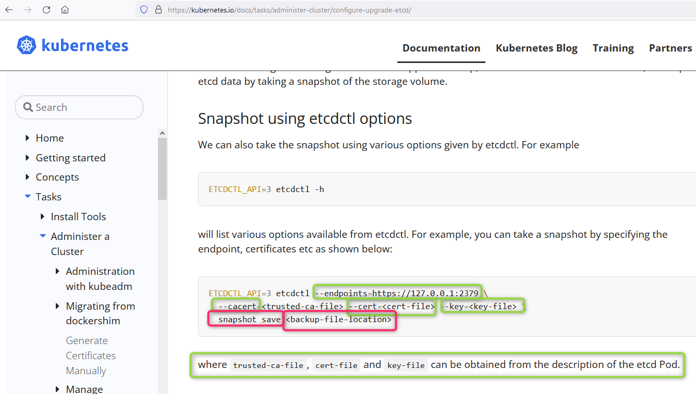

Slide 15
- command:
- etcd
- --advertise-client-urls=https://192.168.1.31:2379
- --cert-file=/etc/kubernetes/pki/etcd/server.crt
- --client-cert-auth=true
- --data-dir=/var/lib/etcd
- --experimental-initial-corrupt-check=true
- --experimental-watch-progress-notify-interval=5s
- --initial-advertise-peer-urls=https://192.168.1.31:2380
- --initial-cluster=master1.example.com=https://192.168.1.31:2380
- --key-file=/etc/kubernetes/pki/etcd/server.key
- --listen-client-urls=https://127.0.0.1:2379,https://192.168.1.31:2379
- --listen-metrics-urls=http://127.0.0.1:2381
- --listen-peer-urls=https://192.168.1.31:2380
- --name=master1.example.com
- --peer-cert-file=/etc/kubernetes/pki/etcd/peer.crt
- --peer-client-cert-auth=true
- --peer-key-file=/etc/kubernetes/pki/etcd/peer.key
- --peer-trusted-ca-file=/etc/kubernetes/pki/etcd/ca.crt
- --snapshot-count=10000
- --trusted-ca-file=/etc/kubernetes/pki/etcd/ca.crt
Server cert
Server key
Endpoints: 2379
Ca cert

Slide 16
ETCDCTL_API=3 etcdctl \
--endpoints=https://127.0.0.1:2379 \ --cacert=/etc/kubernetes/pki/etcd/ca.crt \
--cert=/etc/kubernetes/pki/etcd/server.crt \
--key=/etc/kubernetes/pki/etcd/server.key \ snapshot save /var/lib/etcd-backup.db

Slide 17
04 NOW WE WILL TALK ABOUT
How to restore from snapshot?

Slide 18
ETCDCTL_API=3 etcdctl \
--endpoints=https://127.0.0.1:2379 \
--cacert=/etc/kubernetes/pki/etcd/ca.crt \
--cert=/etc/kubernetes/pki/etcd/server.crt \
--key=/etc/kubernetes/pki/etcd/server.key \
snapshot restore /var/lib/etcd-backup.db \
--data-dir="/var/lib/etcd-backup"

Slide 19
04 NOW WE WILL TALK ABOUT
LAB and Exam preparation

Slide 20
ETCD snapshot & restore
Understanding the basic of etcd
Install etcd package
How to create etcd snapshot?
How to restore from snapshot?
Lab + Exam preparation
Theory + Lab + Document + CKA
https://paypal.me/anishrana20011
Snapshot
ETCDCTL_API=3 etcdctl \
--endpoints=https://127.0.0.1:2379 \ --cacert=/etc/kubernetes/pki/etcd/ca.crt \
--cert=/etc/kubernetes/pki/etcd/server.crt \
--key=/etc/kubernetes/pki/etcd/server.key \ snapshot save /var/lib/etcd-backup.db
Restore
ETCDCTL_API=3 etcdctl \
--endpoints=https://127.0.0.1:2379 \
--cacert=/etc/kubernetes/pki/etcd/ca.crt \
--cert=/etc/kubernetes/pki/etcd/server.crt \
--key=/etc/kubernetes/pki/etcd/server.key \
snapshot restore /var/lib/etcd-backup.db \
--data-dir="/var/lib/etcd-backup"

